Slide 1

NGF Budget Revision FTR Training
UNC Charlotte Budget Office

Slide 2

Path to Non-General Fund Budgets
FY21- Campus Leadership moved UNC Charlotte to an All Funds Budgeting approach to ensure we are good stewards of all resources available to us
  Budget pools applied in Banner at the end of the fiscal year to match activity and rolled into new fiscal year
FY22- UNC System Office required all campuses to provide future fiscal year’s All Funds Budget Report for BOG Approval
  UNC Charlotte Leadership adopts System Office’s reporting structure as campus reporting structure
  Created templates for both current and future fiscal year budget planning
  Budgets applied in Banner via Mass Budget Revisions from templates by Budget Office only (quarterly)
FY23- UNC Charlotte implements new FTR (financial transaction revision) and report central reporting
  Campus leadership reports adopt AFB structure
  New FTR give department level budget managers the tools to better track and understand full scope of budget (anticipated revenue and spend)
Notes:
Allows for monthly budget updates
Clearer understanding and projections of non-general fund revenue sources
During a period with less new money coming to campus this approach allows
Leadership flexibility in planning, because they have a clear understanding of all resources they have access to
Business Officers’ to propose funding for programs/initiatives with an understanding of an increased scope of existing fund types

Slide 3
Training Outline
Defining NGF
New Account
New FTR
Moving Forward
What funds are included for this FTR
Budget Pools
Key differences between General and Non-General Funds
Introducing new account 970102
Understanding the account through scenarios
How To….
Access new FTR
Use new account in FTR
Use the Calculator training tool
Journal Entry vs. Departmental Budget Revision
Monthly Reconciliation
When to use NGF Budget Revision

Slide 4
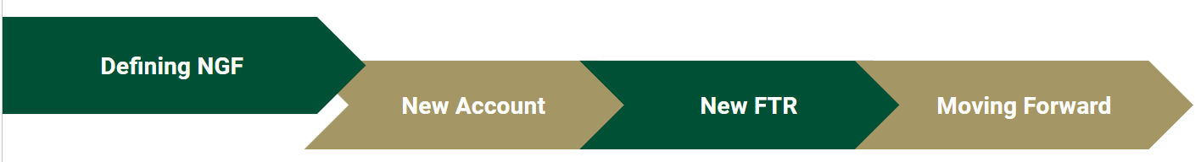
EXCLUDED- EXISTING FTR | EXCLUDED FROM UNC SO AFB | INCLUDE IN NGF FOR FTR
General Fund (100000-119999) 5XXXXX funds (G&C) | Agency Endowment (HXXXXX & RXXXXX) | Overhead Unrestricted Institutional Trusts Auxiliaries Restricted Trust funds

Slide 5
Defining NGF
What is a Budget Pool?
Budget is loaded into a Pool account and used when doing budget revisions
Main Pool Ranges:
  91xxxx – Personal Services (Salaries and Benefits)
  920xxx-922xxx – Purchased Contractual Services
  923xxx – Utilities
  924xxx-928xxx – Purchased Services
  93xxxx – Supplies
  940xxx-948xxx – Property, Plant & Equipment
  949xxx – Art, Library & Learning Resources
  95xxxx – Other Expenses & Adjustments
  96xxxx – Grants, State Aid & Public Assistance
Complete list of Pool Account Codes: https://budget.charlotte.edu/resources/budget-pool-account-codes

Slide 6
Defining NGF
Budget Pool Accounts:
Range of Expenditure Account Numbers (9xxxxx) | Budget Pool Account
91xxxx - PERSONAL SERVICES (SALARIES AND BENEFITS)
911xxx - EPA Non Teaching Salaries | Budget at detail account
912xxx - SPA Salaries | Budget at detail account
913xxx - EPA Teaching Salaries | Budget at detail account
914xxx - Overtime & Premium Pay:
9140xx - Overtime | 914000
9145xx - Premium Pay | 914500
915xxx - Temporary Wages:
9150xx - Student Wages | 915000
915900 - Non Student Wages | Budget at detail account
916xxx - Workers Compensation | 916000
917xxx - Medical Insurance | 917000
918xxx - Optional Retirement | 918000
919xxx - Other Non Pooled Items (State Retirement, LEO, Social Security) | Budget at detail account
920xxx - 922xxx - PURCHASED CONTRACTUAL SERVICES
920xxx - Personal Services Contract | 920000
921xxx - Personal Services (Non Pooled) | Budget at detail account
922xxx - Corporate Services Contract | 922000
923xxx - UTILITIES | 923000
924xxx - 929xxx - PURCHASED SERVICES
924xxx - Miscellaneous Employee Benefits | 924000
925xxx - Domestic Travel | 925000
926xxx - Foreign Travel | 926000
927xxx - Fixed Purchased Services | 927000
928xxx - Other Purchased Services | 928000
93xxxx - SUPPLIES | 930000
940xxx - 948xxx - PROPERTY, PLANT & EQUIPMENT
940xxx - Office Equipment | 940000
942xxx - EDP Equipment | 942000
944xxx - Educational Equipment | 944000
946xxx - Vehicles | 946000
947xxx - Other Equipment | 947000
948xxx - Land, Buildings, & Other Capital Outlay (Non Pooled) | Budget at detail account
949xxx - ART, LIBRARY & LEARNING RESOURCES | 949000
All budget pools are numbered 9xx000 with the exception of premium pay pool (914500).
95xxxx - OTHER EXPENSES & ADJUSTMENTS
950xxx - Miscellaneous Employee Payments | 950000
951xxx - Other Administrative Expense | 951000
952xxx - Fixed Charges | 952000
953xxx - Indirect Cost, Admin Fee (Non Pooled) | Budget at detail account
954xxx - Debt Service (Non Pooled) | Budget at detail account
955xxx - Write Offs (Non Pooled) | Budget at detail account
956xxx - Non Operating Expense (Non Pooled) | Budget at detail account
957xxx - Other Expense (Formerly A FRS GL Obj Code) | Budget at detail account
96xxxx - GRANTS, STATE AID & PUBLIC ASSISTANCE | Budget at detail account
97xxxx - RESERVES | Budget at detail account
98xxxx - INTRAGOVERNMENTAL TRANSACTIONS | Budget at detail account
Notes:
Condensed Chart

Slide 7
Defining NGF
General vs. Non-General Funds
GENERAL FUNDS | NON-GENERAL FUNDS
Revenue held on central funds & units spend against central; budget/plan only for expenses | Revenue sits on fund; budget/plan for revenue, expense and transfer
Benefits covered by central pool; transferred monthly to offset activity | Benefits covered by units; budgeted for the whole year
Must be spent down by June 30th | Can carry over some fund balance
FTR(s): Journal Entries to move expenses; Budget Revision to move budget | FTR(s): Journal entries to move cash or expenses; Budget Revision to change budget plan
Spending cannot exceed overall expense budget; cannot increase budget without additional allocations | Spending cannot exceed revenue and beginning balance; budget can increase if revenue comes in higher than projected
Budget Pools should be cleaned up monthly | Budget should be updated as spending plan changes (reviewed monthly)
Permanent Budget available for spend July 1 and only change with reversions or other communicated changes | Depending on source, revenue collected throughout the fiscal year and can be dependent on customer behavior (enrollment, student accounts, sales, etc.).
Budget Scope = perm budget plus any known 1x allocations | Budget Scope = Beginning balances plus revenue projections (historical trends plus year-specific factors)

Slide 8
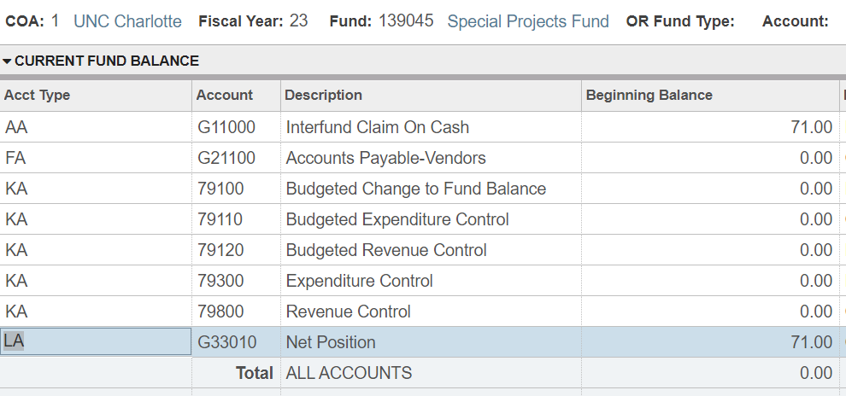
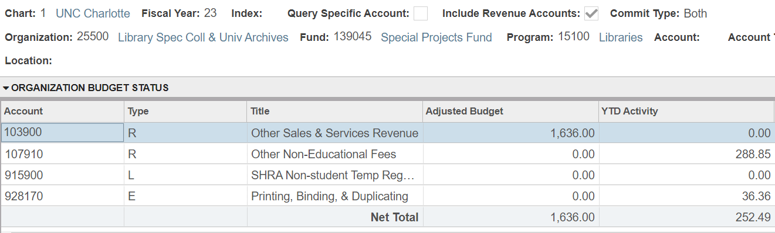
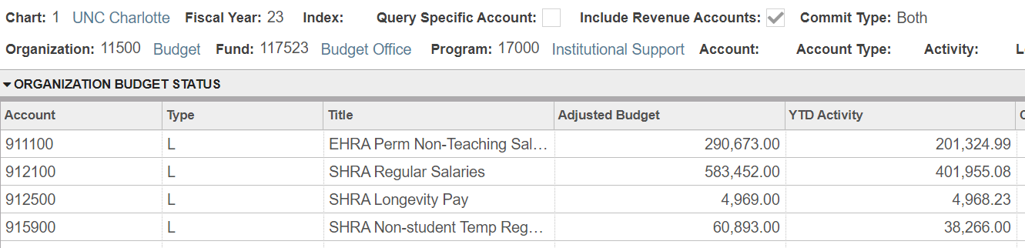
Defining NGF
General vs. Non-General Funds
Held centrally; budget as spend parameters
Reflects annual spend plan
Shows actual spend against annual spend plan
Move budget between pools; no need for transfer codes
Update budget to cover expenses
REVENUE
ADJUSTED BUDGET
YTD ACTIVITY
ADJUSTMENTS
Sits on fund (1XXXXX accounts)
Reflects annual earning & spend plan for fund
Shows actual revenue earned and spend against annual plan
Move expenses between expense accounts
Move revenue via
  transfer codes (8XXXXX) in & out
  distribution codes (1014XX-1019XX)
Update budget to cover current and planned activity (rev/exp/transfer)

Slide 9
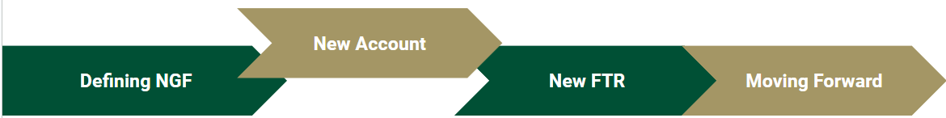
Introducing a new account 970102- Budgeted Impact to Fund Balance
Updated FY23 budgets (AFB workbooks) have been uploaded into banner
  970102 accounts prepopulated on those budget pools
When do I use 970102?
  annual revenue and expenses are not equal; either using some of your fund balance or adding to your fund balance
Allows FTRs to all be net zero
Let’s look at some scenarios to help illustrate when to use this new account…

Slide 10
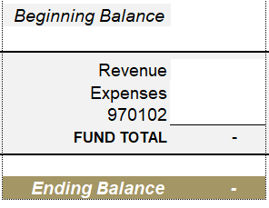
970102 Introduction
New Account
GENERAL MODEL
FTRs all must net to zero (grey areas)
  Revenues reflect as credits (neg. numbers)
  Expenses reflect as debits (pos. numbers)
  970102 can be either as it acts as an offset
Let’s look at some scenarios applied to this model….

Slide 11
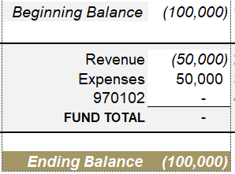
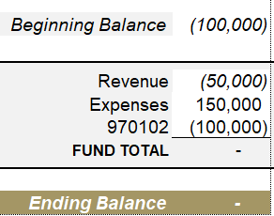
New Account
Visualizing Use of New Account
SCENARIO 1: Spending All Annual Revenue
Expenses are covered by annual revenue
Not touching beginning balance
970102 is not used
SCENARIO 2: Spending All of Fund Balance
Expenses are not covered by annual revenue
Spending all of beginning balance
970102 reflects full balance being spent

Slide 12
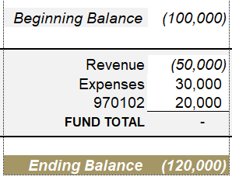
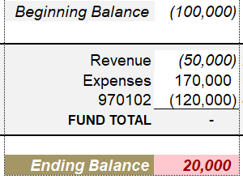
New Account
Visualizing Use of New Account (cont.’d)
SCENARIO 3: Adding to Fund Balance
Expenses are covered by less than full annual revenue
Adding to beginning balance
970102 reflects increase to fund balance
SCENARIO 4: UNALLOWABLE
Expenses are not covered by annual revenue and beginning balance combined
970102 reflects what would be needed to cover expenses
Would leave fund in deficit
You could either move exp off this fund or transfer more rev on to cover the ($20k) deficit and then it would be allowable.

Slide 13
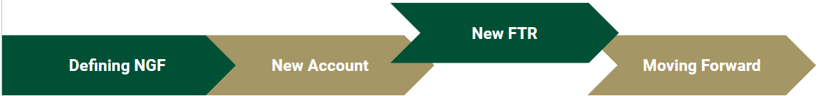
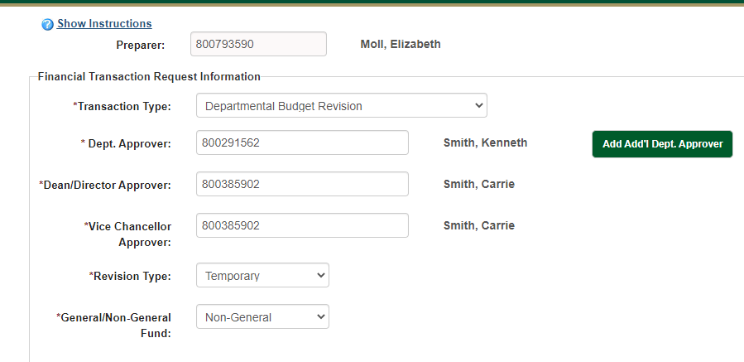
Notes:
Choose GF or NGF- if you do not select you will get a mixture of errors that pop up
Temp or Perm- do you want this change including in the beginning budget for the next fiscal year?Then pick perm. If it’s one time or year specific pick temporary.

Slide 14
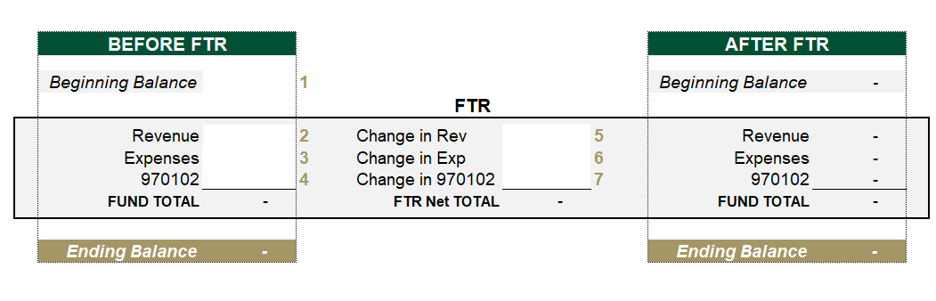
New FTR
970102 “Calculator”
Can be located on our website: https://budget.charlotte.edu/
  Instructions tab included
  Allows you to model out FTR and its impact to a fund
    Conditional formatting insures it’s allowable

Slide 15
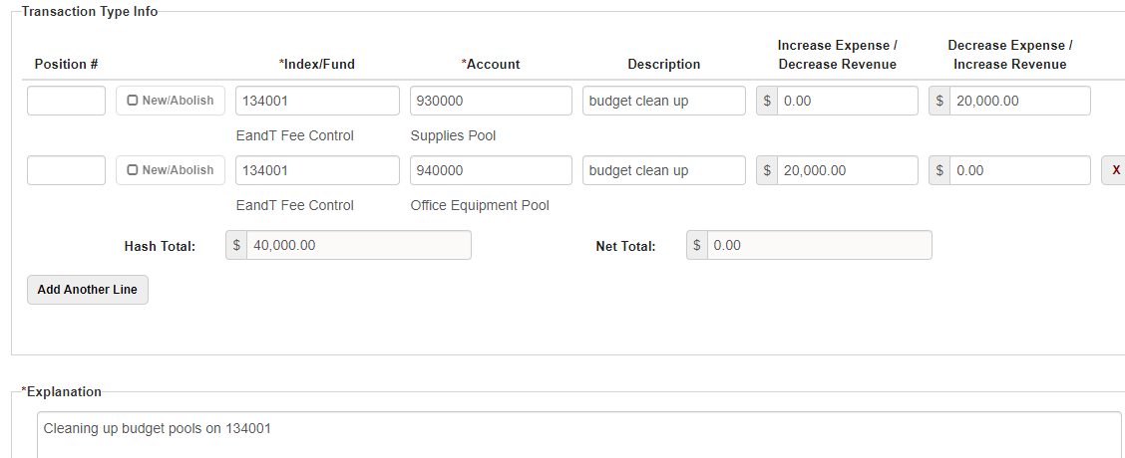
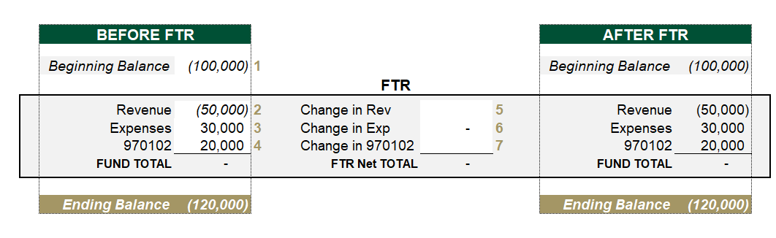
New FTR
Using 970102 in New FTR
Dropping one budget pool, but raising another budget pool equally on the same fund- then you will not need to adjust 970102
Everything nets to zero without using the 970102 offset account!

Slide 16
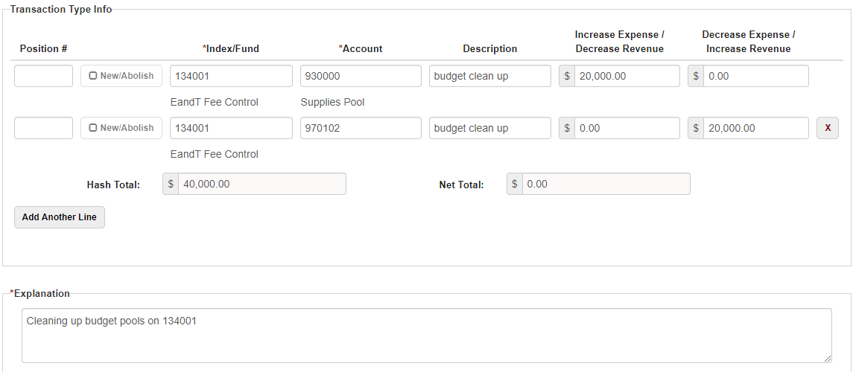
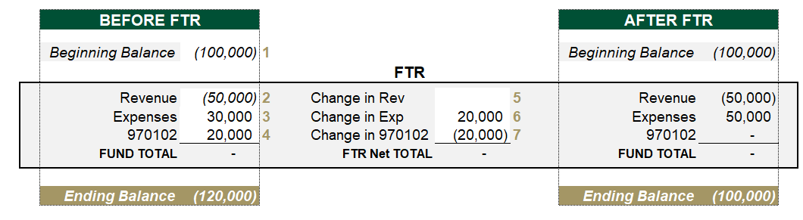
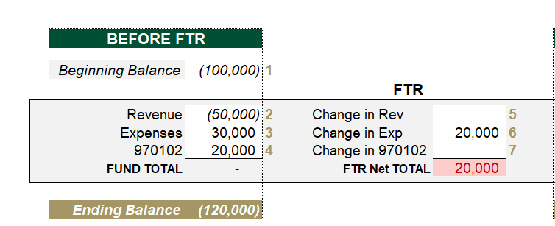
New FTR
Using 970102 in New FTR
Increasing/decreasing budget pool on one fund with no other change = decrease/increase 970102 to offset the other pool’s change
Use 970102 to offset the other changes on the FTR so it nets to zero. Also look how the ending balance is impacted!

Slide 17
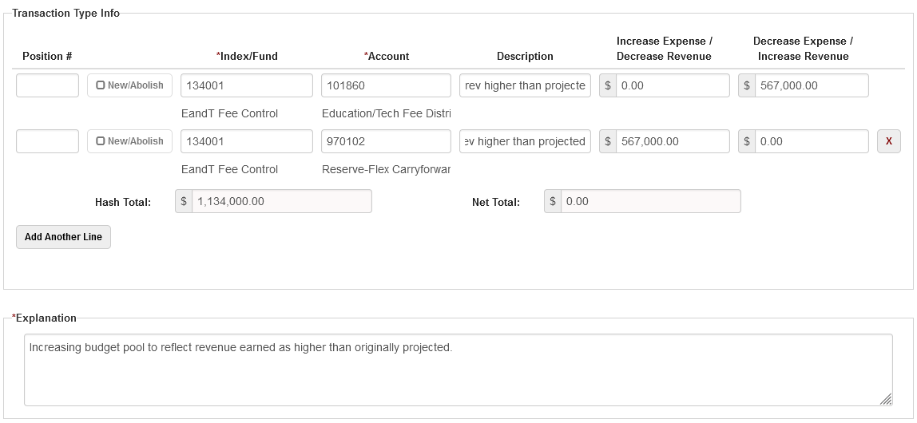
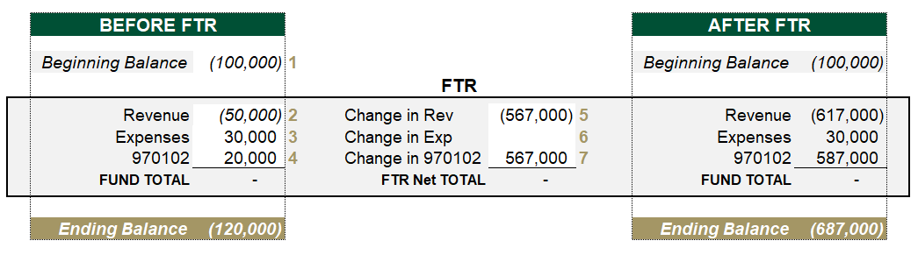
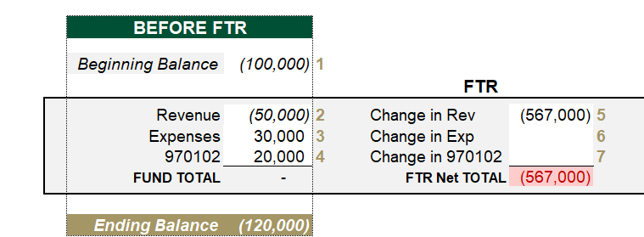
New FTR
Using 970102 in New FTR
Earned more revenue than projected, increase revenue budget = decrease 970102 to make the FTR net to zero
Use 970102 to offset the other changes on the FTR so it nets to zero. Also look how the ending balance is impacted.

Slide 18
New FTR
Journal Entry Vs. Dept Budget Revision
JOURNAL ENTRY
Movement of cash
  Distribute fee revenue to other funds or units
  Transfer revenue via transfer codes
  Reallocate actual expense to other funds or units
Impact seen in YTD activity column
DEPT BUDGET REVISION
Movement of budget
  Update budget pools on funds belonging to your org only
Impact seen in Adjusted Budget column
Notes:
You may move revenue to another unit, but you are only responsible for updating your budget pools on your funds if that was a previously unbudgeted allocation (not already included in your annual plan)
You will never submit a budget revision for the side of the journal entry you do not own.
When to submit the budget revision- up to you…
Before move (if it helps you reconcile)
After move (if it helps you reconcile)
Update at the end of the month (required reconciliation- apply all changes at once)

Slide 19
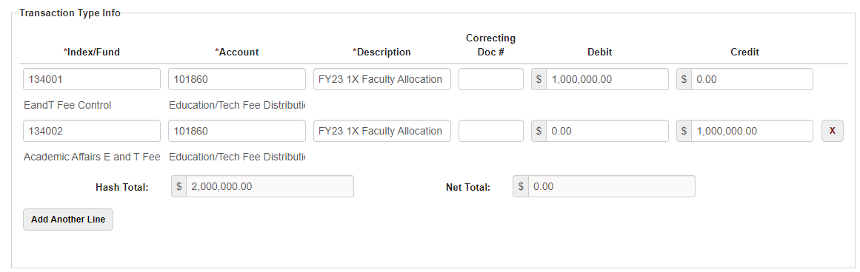
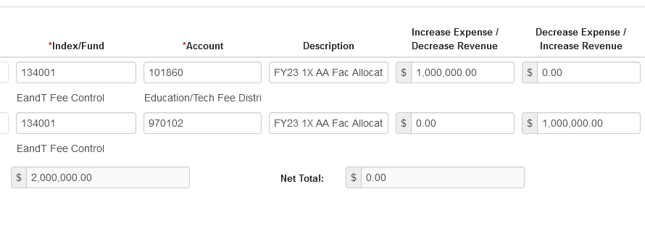
New FTR
Journal Entry Vs. Dept Budget Revision
Changes are made after unbudgeted allocation via dept budget revision
Distribute the revenue out to unit via a journal entry
Notes:
Distributing revenue to other areas
Budget revision for your own fund
Before move
After move
Update at the end of the month

Slide 20
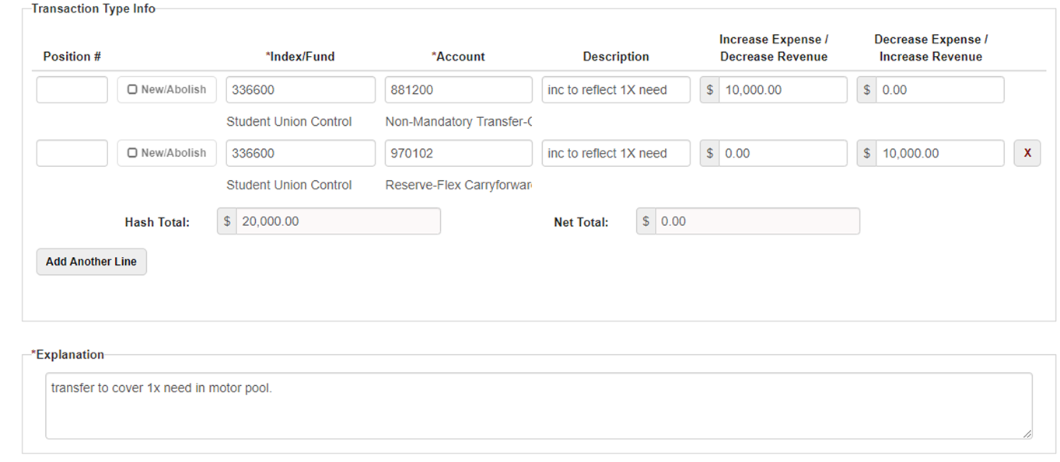
New FTR
Using 970102 in New FTR
Move revenue or expense to an area outside of your unit via JE- then you will need to adjust 970102 on all of your funds involved
Notes:
In this scenario, allocations have gone out from a control fund to various units who all have their own budget team/manager in charge of their fund(s).Your budget revision would only address/update the funds within your fiscal purview. In this case reducing 970102, because this fund will be carrying over less due to allocating to cover a 1x unplanned expense on another fund.
A good bonus to this practice is that if you pull detail for your 970102, and use description that really mean something, you will have a list of the all the unplanned impacts to (whether increasing or decreasing) your fund balance. If you start seeing the same activity on that list year over year, then it’s time to include that activity in your initial budget for the year. This will have you and your team processing less dept budget revisions.
The more we include/project in our budgets the less we have to adjust the budget throughout the year.

Slide 21
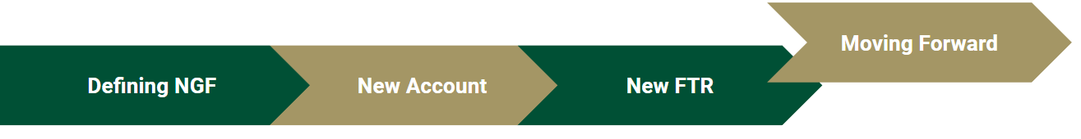
Monthly Reconciliation
  ReportCentral report: Operating Ledger plus beginning balances coming soon
    Until available, Budget Office will send out monthly report
  When do you need to adjust non-general fund budget?
    YTD activity is higher than budget
      Annual revenue and/or transfers in come in higher or lower than projected
      Spending and/or transfers out is higher than what you have budgeted
Keep funds clear of deficits
Beginning budget pools will continue to be rolled and updated with AFB budget pools provided by Business Officers

Slide 22
Moving Forward
When must I submit my FTR Budget Revisions?
These deadlines are for the Budget Office, meaning revisions must be approved at all levels and reach our queue by this time. Please note your division may have a separate deadline for approvals.
Budget Revision Deadlines
July | Wednesday the 26th
August | Friday the 25th
September | Monday the 25th
October | Wednesday the 25th
November | Friday the 24th
December | Friday the 15th
January | Wednesday the 25th
February | Wednesday the 22nd
March | Friday the 24th
April | Monday the 24th
May | Friday the 26th
June | Monday the 19th

Slide 23

Moving Forward
Open Swim Sessions for the new FTR will be scheduled and made available to all.
Attendees will need to:
Have watched this training
Come to open swim with FTRs they are trying to build.
These Open Swims will be drop-in assisted practice sessions that will build off of this training, not another FTR presentation or additional Non-General Funds training.
For more Non-General Funds content, please see the full Budget Office training on the website or sign up for one of that training’s in-person sessions.
Thank you!

